Slide 1
File System Herarchy
The Linux File Hierarchy Structure or the Filesystem Hierarchy Standard (FHS) defines the directory structure and directory contents in Unix-like operating systems. All files and directories appear under the root directory /, even if they are stored on different physical or virtual devices.

Slide 2
File System Herarchy
/bin – User Binaries
/sbin – System Binaries
/etc – Configuration Files
/dev – Device Files
/proc – Process Information
/var – Variable Files
/tmp – Temporary Files
/usr – User Programs
/home – Home Directories
/boot – Boot Loader Files
/media – Removable Media Devices

Slide 3
Permissions
Every file and directory in your UNIX/Linux system has following 3 permissions defined for all the 3 owners discussed above.
1. Read: This permission give you the authority to open and read a file. Read permission on a directory gives you the ability to lists its content.
2. Write: The right permission gives you the authority to modify the contents of a file. The write permission on a directory gives you the authority to add, remove and rename files stored in the directory. Consider a scenario where you have to write permission on file but do not have write permission on the directory where the file is stored. You will be able to modify the file contents. But you will not be able to rename, move or remove the file from the directory.

Slide 4
3. Execute: In Windows, an executable program usually has an extension ".exe" and which you can easily run. In Unix/Linux, you cannot run a program unless the execute permission is set. If the execute permission is not set, you might still be able to see/modify the program code(provided read & write permissions are set), but not run it.

Slide 5
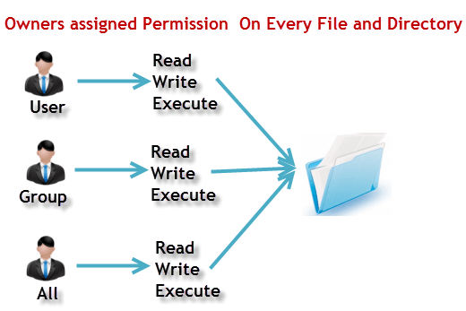
r = read permission= 4
w = write permission= 2
x = execute permission= 1
- = no permission= 0

Slide 6
Changing file/directory permissions with 'chmod
1. Symbolic method:
g+w — adds write access for the group
o-rwx — removes all permissions for others
u+x — allows the file owner to execute the file
a+rw — allows everyone to read and write to the file
ug+r — allows the owner and group to read the file
g=rx — allows only the group to read and execute (not write)
2. Numeric Method:
-rw------ (600) Only the owner has read and write permissions.
-rw-r--r-- (644) Only the owner has read and write permissions; the group and others have read only.
-rwx------ (700) Only the owner has read, write, and execute permissions.

Slide 7
5. Maximum : The maximum number of days the password is valid (after that user is forced to change his/her password)
6. Warn : The number of days before password is to expire that user is warned that his/her password must be changed
7. Inactive : The number of days after password expires that account is disabled
8. Expire : days since Jan 1, 1970 that account is disabled i.e. an absolute date specifying when the login may no longer be used.

